Slide 1

Kids Keeping Food Stands Safe
An Interactive Module for Temporary Youth Food Stand Workers
Module designed by Bridget Curley, Former Program Assistant, and Julie Garden-Robinson, Food and Nutrition Specialist; revised in 2014 by Kimberly Beauchamp, Food Safety/Food Entrepreneur Extension Specialist and in 2024 by Julie Garden-Robinson
2024

Slide 2
How to work though this program
Click “Slide Show” then click “From Beginning” to engage the interactive parts of this presentation.
Click the left mouse button (or the down arrow) to go to the next bullet or slide.
Before you begin the lesson, click on the
Pre-survey link found in this presentation.
When you are finished with the survey questions, close the window to return to this module.

Slide 3
When you see this symbol ,
click your mouse once to see answer.
When you see this symbol , “stop and think” of the answer. Then, click your mouse to see the answer.

Slide 4
Near the end of the module, you will take a Post-survey.
  The Post-survey survey will open in
  a new window.
  When you are finished with the survey, close the window and return to this module.

Slide 5
It’s Time to Take the Pre-survey
Click here to begin the survey.
Return to this module when you are done with the Pre-survey.

Slide 6
Serving food to the public can be a fun experience
Remember:
  Personal safety and food safety come first.
  Be careful when working, and keep a clean workplace.

Slide 7
Question Time
Working at a temporary food stand should be:
  Fun
  Boring
  Unenjoyable
    Click to see answer
The answer is a. We hope the experience is enjoyable for those who have the chance to help out.

Slide 8
Stay safe while working
Do not lift heavy objects by yourself. Get help!
Be extra careful when working with sharp objects,
such as knives.
Be careful around stoves and other hot equipment.
Do not burn yourself. Handle hot foods carefully.
Keep the floors clean and clear of objects so you don’t trip over anything.
Clean up spills to avoid slipping.

Slide 9
  Be careful when working with “potentially hazardous” or “time and temperature control for safety (TTS)” foods.
    These are foods that may become contaminated if not stored or cooked properly.
  Examples of “potentially hazardous” or (TTS) foods:
Sandwiches made with meat
Fish
Poultry
Salads
Egg products
Meat
Milk

Slide 10
You are responsible for identifying “potentially hazardous” foods.
Click below to reveal the “potentially hazardous” or TTS foods.
Potentially
Hazardous
Potentially
Hazardous
Potentially
Hazardous

Slide 11

Keep your work area clean and free of germs
  A clean area helps reduce the risk of spreading “germs” such as bacteria, into food.
Germs can contaminate the food.
People can get very sick from eating contaminated food.

Slide 12
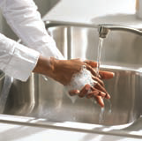
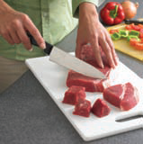
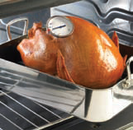
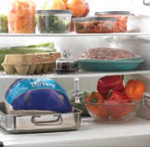
What are the Four Steps to Food Safety?
CLEAN
SEPARATE
COOK
CHILL
When people get an illness from eating contaminated food, it is because something probably went wrong in one of these areas.

Slide 13
True or False
True or False
The important food safety areas to remember are clean, separate, cook and chill.
Click to see the answer

Slide 14


Slide 15
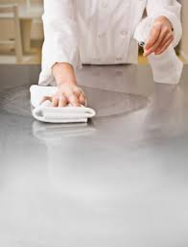
Cleaning and Sanitizing
Keep work areas, equipment and dishes clean and sanitized.
  “Sanitized” means you have used a sanitizer such as a bleach-water rinse, after cleaning.
Cleaning and sanitizing counters and dishes helps stop bacteria in their tracks!

Slide 16
Clean surfaces such as counters and tables by wiping them with paper towels and sanitizer solution.
Homemade sanitizer solutions can
be made by mixing 1 tablespoon
of chlorine bleach with 1 gallon
of water.
Do not use sponges or cloth towels to clean up spills.

Slide 17
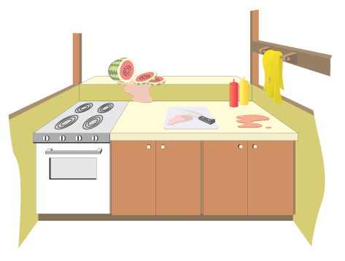
Inspect areas where food is prepared, eaten and served and identify areas that need to be cleaned
Click to see the three areas that need cleaning in this picture
Dirty
Dirty
Dirty

Slide 18
20 Seconds
A Homemade sanitizer solution can be created from ___________?
  1 cup of water and 1 tablespoon of chlorine bleach.
  1 gallon of water and 1 tablespoon of chlorine bleach
  1 quart of water and 3 tablespoons of chlorine bleach.
Click to reveal answer

Slide 19
Cleaning dishes
Scrape off excess food before washing dishes
#1) Wash dishes with warm, soapy water.
#2) Rinse off the soap with hot water.
#3) Next, rinse with the sanitizing solution.
  Sanitizing reduces the amount of germs on each item.
  Just because something looks clean does not mean it is sanitized or safe to use.
#4) Allow dishes to air dry.
  Dishtowels can spread bacteria from dish to dish.

Slide 20
You have been assigned to help wash dishes. What is the correct order to clean dishes and utensils properly?
Click and the correct order will appear.
Sanitize
Scrape
Air dry
Rinse
Wash

Slide 21
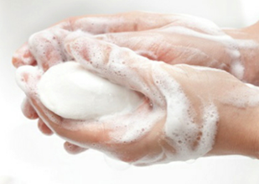
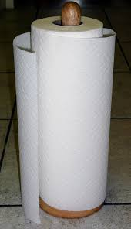
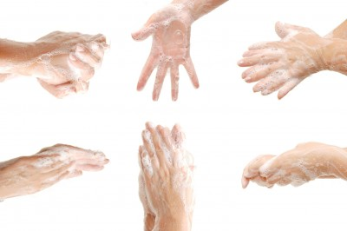
Volunteer Health and Hygiene
Wash your hands before starting work and many times during your shift.
Wash hands in warm, soapy water for at least 20 seconds.
Dry them using a paper towel and throw the towel in the garbage.

Slide 22
20 Seconds
Is that a long time? How do you
know when the 20 seconds are up?
  Sing “Twinkle, Twinkle, Little Star”
  Slowly count 20 Mississippis
  Hum the “ABC” song to yourself
  All are good ideas
Click to reveal answer
Using any of these ideas while washing your hands will help you wash them long enough to get them clean!

Slide 23


Always Wash Your Hands:
… Before touching food or clean surfaces
… After you touch food
… If you touch your face, touch your eyes,
touch your hair, blow your nose,
or go to the bathroom
… If you handle money
  Money is covered in germs.
  If you touch money while wearing gloves,
  wash your hands before touching food.
… If you use your phone
  Cell phones are covered in germs.
  If you use your phone, wash your hands
before touching food or clean surfaces.

Slide 24
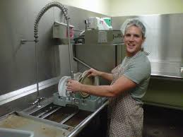
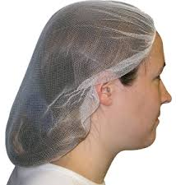
Keep Neat and Clean!
Before starting your shift, have
a clean appearance and a
clean apron to keep your
clothes from becoming dirty.
If you have long hair, tie it back.
(such as a ponytail or braid)
Wearing a hair restraint is a good idea so loose hairs do not get into anyone’s food.

Slide 25
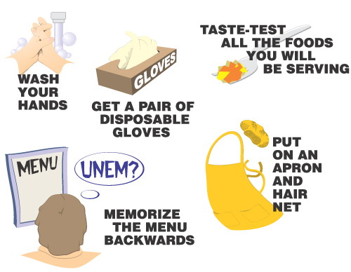
You are about to start your shift.
Which of the following should you do before starting?
Click to reveal answer.
Not Important
Not Important

Slide 26
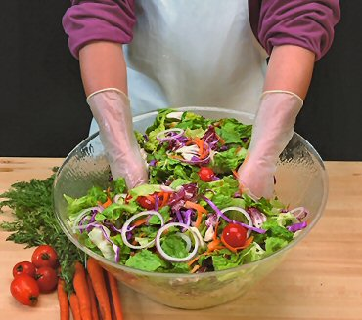
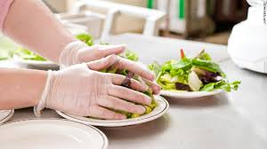
Glove Safety
Everyone should wear disposable
gloves when handling food.
Be sure to put on new gloves,
after washing your hands.
Always change your gloves, if
they become dirty or torn, or if
you switch tasks.
  For example, if you are serving pizza and then switch to serving cookies, change your gloves to prevent cross contamination.

Slide 27


Slide 28
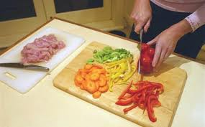
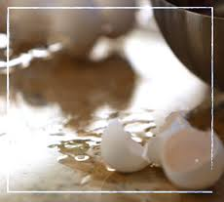
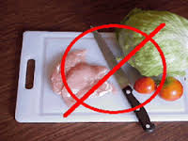
Contamination and Foodborne Illness
Separate foods to reduce the risk
of transferring germs from one
food to another.
        Foods can pick up germs if
        it touches a surface that has
        not been cleaned and
        sanitized properly.
Never allow raw food
to come in contact with
cooked or ready-to-serve food.

Slide 29
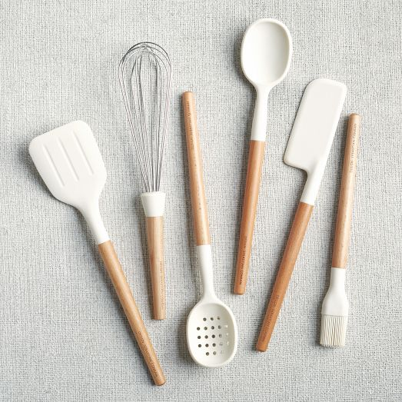
Serving Utensil Use
Before starting your shift, have
the correct supplies available.
Have serving utensils, such as
tongs, ladles and scoops, ready
so you minimize your food contact.
Have enough utensils available for each different food.
  For example, you do not want to use the hot dog tongs to grab a cookie.

Slide 30

If you need to touch food,
only do so wearing clean
disposable gloves.
When filling cup, plate and napkin dispensers, fill from the back or bottom so all products are used in the order you fill them.

Slide 31
Match the following foods with the proper serving utensils :
Click and the correct answers will appear
1. Hot dog a. Gloved hand
2. Mashed potatoes b. Ladle
3. Soup c. Scoop
4. Nacho chips d. Tongs
1. Hot dog d. Tongs
2. Mashed potatoes c. Scoop
3. Soup b. Ladle
4. Nacho chips a. Gloved hand

Slide 32
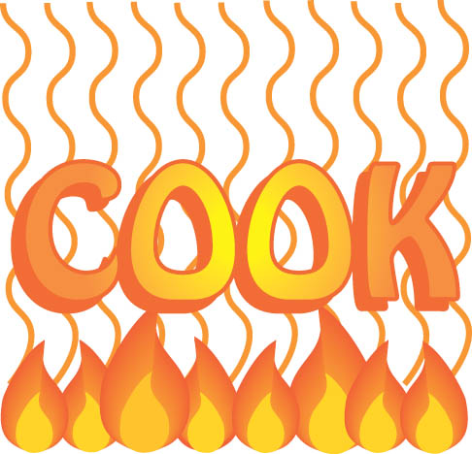

Slide 33
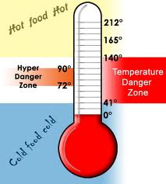
Preparing, cooking and serving food
Keep the temperature “danger zone” in mind.
  Danger Zone = Temperatures between 41 F and 140 F.
At these temperatures, germs and bacteria can grow quickly.
An adult should check foods with a thermometer frequently to ensure that temperatures are safe.

Slide 34
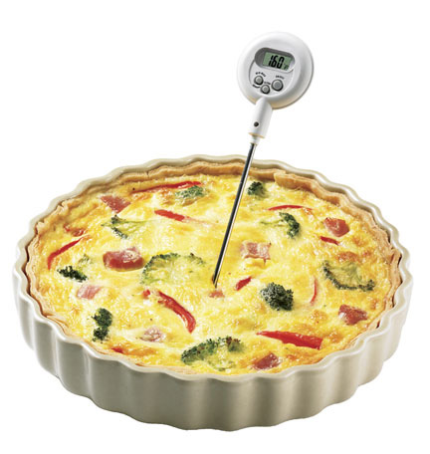
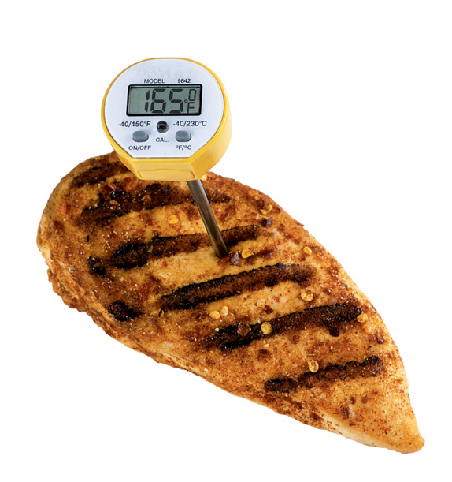
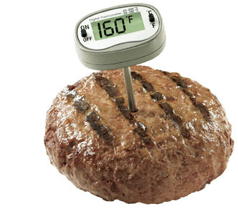

You noticed some of the equipment is not heating foods correctly.
Pick out the foods in the temperature danger zone.
Click to see the answer.
Poultry should be heated to 165F not 65F

Slide 35
Serving Customers
Food should be served to customers with
disposable dishes, such as paper plates, foam
cups and plastic silverware.
When handing plates, cups or silverware to customers, never touch the part that will come in contact with food or the person’s mouth.
If customers ask you to carry items for them, take only what you can handle.

Slide 36


You have to serve food to customers
Click to reveal the portion of these objects that you should touch while passing food to customers.

Slide 37
Before You Start
Ask for instructions if you are uncertain of the area or the station you will be working in.
  Are you feeling unsure of the area?
  Are you feeling unfamiliar with the station?
  Do you feel a lack experience with the equipment?
  Ask an adult before starting.

Slide 38


Slide 39
Storing Food
Store food in appropriate containers so the food is safe for later use.
Use shallow containers to store food in refrigerator.
  Thick foods, such as sloppy joe meat or chili, should be chilled in a container no more than 2 inches deep.
  Other foods, such as a thin soup, can be stored 3 inches deep.

Slide 40
True or False
True or False
The shallower the food level, the quicker it will chill to a safe temperature.
Click to see the answer.

Slide 41
Label Containers
Cover food with a lid or plastic wrap before putting it away.
Label the container with the date, time and what is in it.
  This allows the next person to identify the contents without taking it out and uncovering it.
  Writing the date and time lets people know when the food was prepared and how long it is safe to use.

Slide 42
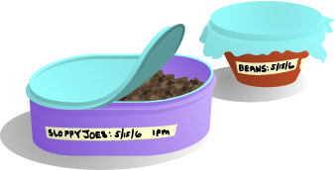
Which containers are labeled correctly?
Click to see the answer.
A.
A. The date and contents are both listed
B.

Slide 43

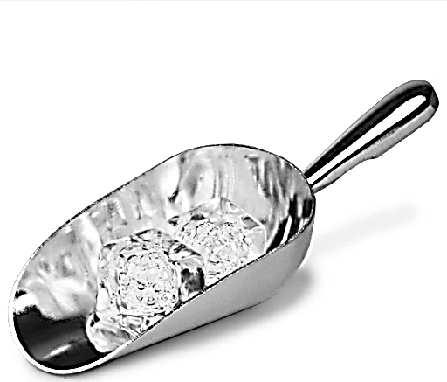
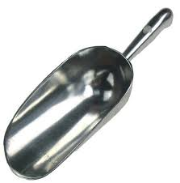
Ice Safety
Food safety also applies to ice served in drinks.
Remember, ice touches the liquids that customers will drink.
Do not touch the ice with your hands, or scoop the ice with a cup.
Use a metal scoop when adding ice to drinking cups or ice coolers.

Slide 44
Time to Take the Post-survey
After completing all the activities and review questions, you are ready to take the survey! Good luck!
Click here to begin Post-survey!

Slide 45
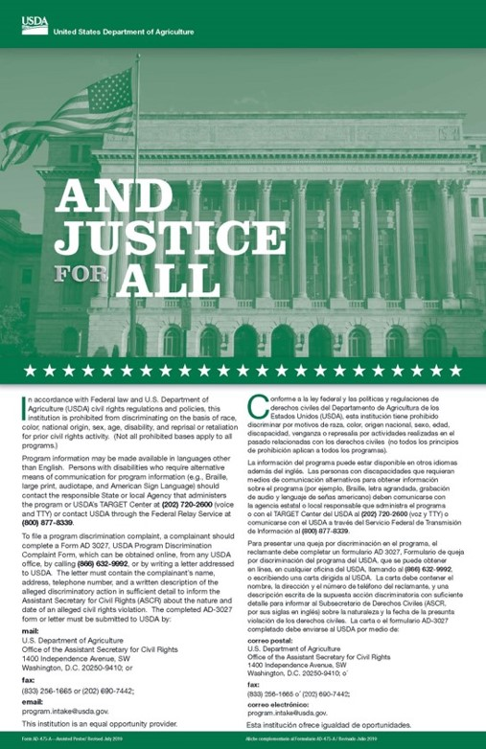
Nondiscrimination Statement
NDSU does not discriminate in its programs and activities on the basis of age, color, gender expression/identity, genetic information, marital status, national origin, participation in lawful
off-campus activity, physical or mental disability, pregnancy, public assistance status, race, religion, sex, sexual orientation, spousal relationship to current employee, or veteran status,
as applicable. Direct inquiries to Vice Provost, Title IX/ADA Coordinator,
Old Main 201, (701) 231-7708, ndsu.eoaa@ndsu.edu.

Slide 46
Do you want to learn more?
Visit www.ag.ndsu.edu/food/food-safety
To leave this presentation,
press the “Escape” key.
NDSU is an equal opportunity institution.

